Slide 1
Transportation Systems Management and Operations (TSMO):
Getting More from Our Existing System

Slide 2
Disclaimer
The U.S. Government does not endorse products or manufacturers. Trademarks or manufacturers’ names appear in this presentation only because they are considered essential to the objective of the presentation. They are included for informational purposes only and are not intended to reflect a preference, approval, or endorsement of any one product or entity.

Slide 3
1/4 - Transportation Systems Management and Operations (TSMO): Getting More from Our Existing System
Expanding Travel Choices to Move More People
49% of
shared mobility
trips replaced
single-occupant vehicles.¹
Managed lanes and
express bus services
moved up to
48% more people.²
Example benefits are presented above. For more information on TSMO strategies and benefits, visit
https://ops.fhwa.dot.gov/plan4ops/focus_areas/integrating/operations_strategies.htm.
Images Source: USDOT/Getty

Slide 4
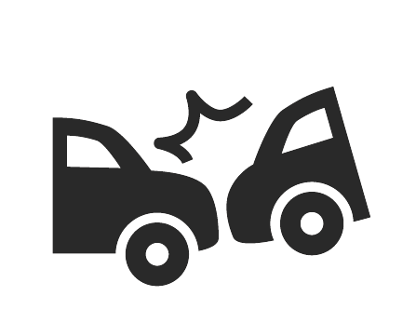

2/4 - Transportation Systems Management and Operations (TSMO): Getting More from Our Existing System
Keeping Lanes Open Increases the Value of Investments
Freeway
Courtesy Patrol³
Smart
Work Zones⁴
Traffic Incident Management Systems⁵
15:1
10:1
8:1
Example benefits are presented above. For more information on TSMO strategies and benefits, visit
https://ops.fhwa.dot.gov/plan4ops/focus_areas/integrating/operations_strategies.htm.
Images Source: USDOT/Getty

Slide 5
3/4 - Transportation Systems Management and Operations (TSMO): Getting More from Our Existing System
Making Travel Times More Reliable
Increased travel time reliability accounted for 68% of the benefits of using congestion-priced lanes.⁶
Dynamic late lane merging in work zones reduced delays by 67%.⁷
Truck parking and management systems reduced parking search time with a benefit-cost ratio of 4:1.⁸
$
Example benefits are presented above. For more information on TSMO strategies and benefits, visit
https://ops.fhwa.dot.gov/plan4ops/focus_areas/integrating/operations_strategies.htm.
Images Source: USDOT/Getty

Slide 6

4/4 - Transportation Systems Management and Operations (TSMO): Getting More from Our Existing System
Improving Travel Time without Increasing Capacity
Regional signal retiming reduced delays by 23%.⁹
Adaptive signal control reduced travel time
by 9.4%.¹⁰
Active Transportation Management Systems may reduce peak period
travel times by up to 21%.¹¹
Example benefits are presented above. For more information on TSMO strategies and benefits, visit
https://ops.fhwa.dot.gov/plan4ops/focus_areas/integrating/operations_strategies.htm.
Images Source: USDOT/Getty

