Slide 1
Connecting TSMO and Maintenance Executive summary (ES)
MAINTENANCE
Presenter Name
Date

Slide 2
Executive Summary

Slide 3

Transportation Landscape Is Changing (ES)
Limited funds
Advances in technology
Customer needs and expectations
Better understanding of causes of congestion
Source: Missouri Department of Transportation flickr
Notes:
The transportation landscape is changing, and doing business the way it has been done in the past is no longer effective. For example, previously, congestion issues were primarily addressed by funding major capital projects (such as adding lanes or building new interchanges and roads) to address physical constraints, such as bottlenecks. Operational improvements were typically an afterthought; they were considered after the new infrastructure was already added to the system. Today, transportation agencies are facing trends that create a growing demand for travel with less funding and space to work with. As a result, we can no longer build our way out of congestion.
Trends we see today include:
Limited funds. Transportation agencies on the Federal, State, and local levels have for years been tasked with doing more with limited resources. State departments of transportation (DOT) are always looking for innovative, lower-cost ways to get people and goods to their destinations more safely and reliably.
Advances in technology. Transportation agencies can leverage technology and data to develop solutions to address congestion issues. However, the traveling public expects fast, reliable, and “smart” transportation, given the advancement in consumer technologies (smartphones, applications, global positioning systems), privately owned mobility services, shared mobility, and the availability of more information.
Changing customer needs and expectations. There is a greater demand for accountability for public officials to ensure that public funds are spent to maximize the performance of the transportation system in the most equitable and cost-effective way. This creates a trend toward “performance-based” programs. The traveling public is seeking relief from unexpected delays in their trips. There is also a greater focus on addressing climate change and offering multimodal transportations options and solutions for the pedestrian, bicyclist, and transit rider.
Better understanding of the causes of congestion. Research has shown that while some congestion may be caused by typical morning and evening rush hours, a significant amount comes from non-recurring events, such as crashes, breakdowns, work zones, weather, and special events. Work zones are frequently active at night to avoid increasing congestion during the day when there is greater demand on the system. While this can mitigate congestion, it can create a worker safety problem with fatigued workers who may be working multiple shifts.
Source: FHWA, “Addressing the Nation’s Transportation Challenges with Transportation Systems Management and Operations.” Available at: https://ops.fhwa.dot.gov/publications/fhwahop19085/fhwahop19085.pdf
Image Source: https://flic.kr/p/QNwCuy

Slide 4
How Are State Departments of Transportation (DOTs) Responding to the Changes? (ES)
Transportation Systems Management and Operations (TSMO)
TSMO is an integrated set of strategies to optimize the operational performance of the existing transportation system.
TSMO approaches performance from a systems perspective, spanning corridors, jurisdictions, modes, and agencies.
TSMO helps agencies balance supply and demand on the system and provide flexible solutions to manage dynamic conditions.
TSMO can complement capacity projects or, in some cases, can provide lower-cost, faster alternatives.
Notes:
How are State DOT’s adjusting and responding to these changes?
Transportation systems management and operations (TSMO) is a solution.
Transportation systems management and operations (TSMO) is becoming an increasingly popular approach in departments of transportation (DOTs) to make the most of the existing transportation infrastructure. It optimizes system capacity, improves safety, and enhances system performance through strategies that can be applied in the near term for less money than major construction. TSMO shares many goals with maintenance in terms of system preservation and optimizing the operations and safety of the transportation system.
Some elaboration on what is on the slide.
TSMO is an integrated set of strategies to optimize the operational performance of the existing transportation system:
Note: The definition at the top of the slide is an abridged version of the Federal Highway Administration TSMO definition found here: https://ops.fhwa.dot.gov/tsmo
TSMO approaches performance from a systems perspective
It spans corridors, jurisdictions, modes, and agencies
TSMO takes a holistic approach to managing performance that looks beyond a single corridor (i.e., are changes to a specific corridor causing a mobility issue nearby?), jurisdiction (i.e., are management systems coordinated across jurisdictional boundaries?), mode (i.e., are we using all modes optimally to meet our performance goals?), and agency (i.e., how can we improve collaboration with law enforcement or transit agencies to improve performance?)
TSMO helps agencies balance supply and demand on the system and provide flexible solutions to manage dynamic conditions:
Examples include ramp metering, managed lanes, and congestion pricing
TSMO can complement capacity projects or, in some cases, can provide lower-cost, faster alternatives
TSMO seeks to provide lower-cost alternatives to capacity projects when operational strategies may produce equal or better results – or when operational strategies may be able to produce results faster. It does not seek to eliminate capacity projects in cases where a capacity project is the best solution. Rather, TSMO provides agencies with more options

Slide 5
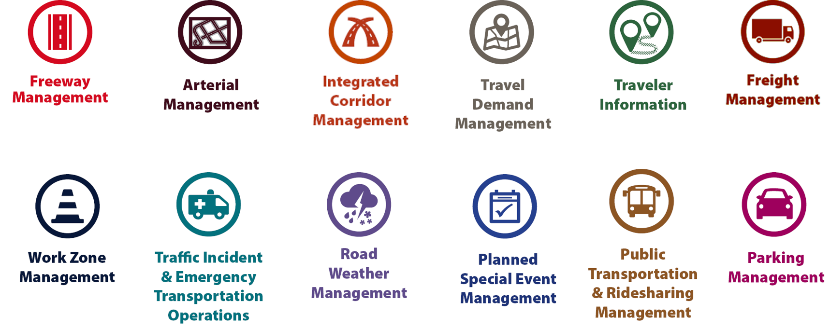
Examples of TSMO Strategies (ES)
Notes:
This slide illustrates the array of operational strategies that fall under the TSMO umbrella that can be used individually or in combination with each other. This list is not exhaustive, but it highlights the key buckets of strategies that are priorities for many agencies.
Examples of other TSMO strategies include:
Traffic signal coordination
Transit signal priority
Special event management
Congestion pricing
Active transportation and demand management
Connected/automated vehicles
Completing multimodal networks

Slide 6
TSMO Supports Many Department of Transportation Goals (ES)
Reduced congestion
Smoother and more reliable traffic flow
Improved safety
Less wasted fuel and cleaner air
Increased economic vitality
Improved quality of life
More efficient use of resources
Notes:
This slide highlights some common DOT goals that TSMO strategies support.

Slide 7
TSMO Strategies Support Maintenance (ES)
Advance warnings of maintenance, weather, and adverse road conditions
Traveler information to:
  Reduce traffic in work zone
  Reduce impacts to traveling public
Active traffic management strategies:
  Variable speed limits
  End-of-queue warning
  Lane control
  Ramp metering
  Active detours
Traffic management in work zones
Road weather management
Notes:
TSMO strategies that are helpful in increasing safety and mobility around maintenance activities include the following:
Posting messages to variable message signs about maintenance work ahead enables drivers to be more alert as they drive by workers or to divert to another facility and avoid the work area. Operators at transportation management centers in the area are important partners in communicating alerts to travelers
Disseminating traveler information prior to maintenance activities alerts travelers to the time and location of traffic disruptions. By getting this information out early to potential travelers, DOTs can avoid or lessen demand on the facilities where maintenance work is occurring
Activating existing active traffic management strategies manages traffic on the facility dynamically. Examples include variable speed limits to smooth traffic flow and reduce collisions, dynamic shoulder use to add capacity when needed, queue warning systems to prevent incidents, and lane control to indicate which lanes are closed ahead
Coordinating with operators of potentially impacted jurisdictions to plan for and activate detours, signal timing, and ramp meter changes, or to change signal timing smooths the flow of traffic when maintenance work impacts lanes and traffic flow near intersections
Managing traffic within work zones
Supporting road weather management with weather-related detection systems, traffic control strategies, and traveler information
TSMO strategies may be used to reduce or delay construction projects. If capacity expansion can be minimized, this means less highway infrastructure to maintain in the future.

Slide 8
Maintenance Supports TSMO (ES)
Preserves transportation system for safe and reliable travel
Maintains TSMO assets
Supports design and implementation of TSMO assets
Provides real-time information from maintenance vehicles (tracking, dash cameras, etc.)
Notes:
Maintenance serves an important role in preserving the existing system, enabling safe and reliable travel on the system.
Maintenance staff keep the physical assets or ITS necessary for many TSMO functions in good operating condition. Assets such as traffic signals, ramp meter/count stations, closed-circuit television cameras, variable message signs, roadway weather information systems (RWIS), and fiber-optic communications infrastructure must be repaired and replaced when necessary to enable the dissemination of traveler information and active traffic management.
Maintenance staff can support roadway design decisions based on potential impacts to maintenance. This includes accessing ITS devices and other TSMO-related equipment for maintenance. Maintenance staff should also provide input to the asset management of ITS devices to ensure that ITS devices are scheduled for maintenance and updated at the appropriate frequency.
Maintenance fleet information from automatic vehicle location (AVL) systems can provide data for dynamic message signs and active traffic management. Maintenance logs can also verify roadway incidents, traveler information and incident response.

Slide 9
Opportunities for Coordination (ES)
TSMO training for maintenance personnel
Information sharing between maintenance and TSMO for decision support
TSMO infrastructure included in asset management and maintenance management systems
Road weather management and emergency operations
Maintenance contracts including performance standards, vendor qualifications, maintenance management systems, and spare parts
Work zone management policy development
TSMO program planning
TSMO committees
Design and deployment of TSMO assets
Notes:
There are numerous opportunities to enhance coordination between TSMO and maintenance, as illustrated in these bullets.
TSMO training for maintenance personnel for both a general understanding of TSMO and maintenance needs for TSMO assets
Data sharing between maintenance and TSMO to support decisions regarding where maintenance is needed to better support operations, such as traffic incident management staff sharing data on maintenance needs following an incident.
TSMO infrastructure included in asset management and maintenance management systems
Road weather management and emergency operations
Maintenance contracts including performance standards, vendor qualifications, maintenance management systems, and spare parts
Engage TSMO personnel in work zone management policy development
Engage maintenance personnel in TSMO program planning
Include maintenance in TSMO committees
Involve maintenance in design and deployment of TSMO assets such a variable message signs, gantries for managed lanes, and ramp meters.
(Training focus should be on understanding TSMO, what it offers, and how it can be used to support maintenance.)

Slide 10
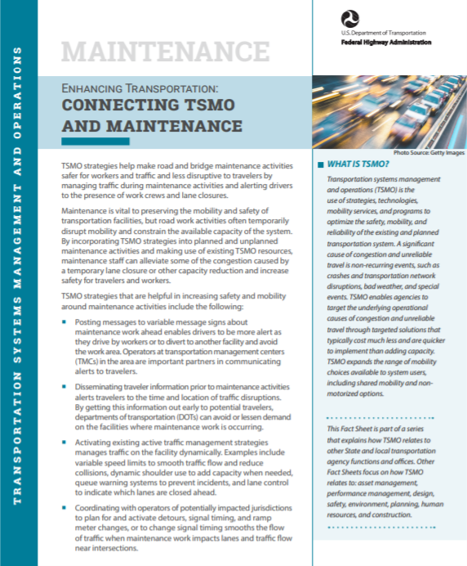
Next Steps (ES)
Bring TSMO and maintenance leaders together to identify areas of common interest and mutual objectives
Find out how TSMO strategies are already supporting maintenance goals
Discuss where TSMO can make an even greater impact on maintenance goals
Begin joint efforts to improve the TSMO and maintenance connection
To learn more: https://ops.fhwa.dot.gov/publications/fhwahop18090/fhwahop18090.pdf
Source: FHWA
Notes:
Bring TSMO and maintenance leaders together within your agency to identify areas of common interest and mutual objectives. This can build understanding of and appreciation for the priorities, concerns, and issues addressed in both maintenance and TSMO and look for natural overlaps between the two areas.
Find out how TSMO strategies are already supporting maintenance goals. For example, system preservation and management is a common goal between maintenance and TSMO. Exploring TSMO strategies together helps personnel from both areas understand the relationship between goals and the ways TSMO strategies can be used to advance those goals.
Discuss where TSMO can make an even greater impact on maintenance goals. For example, system and operational data can be shared to support both maintenance and operations.
Begin joint initiatives to improve TSMO/operations and maintenance.
Note that additional resources are listed at the end of this presentation, including a fact sheet on connecting TSMO and maintenance, which is available at https://ops.fhwa.dot.gov/publications/fhwahop18090/.

Slide 11
End of Executive Summary

Slide 12
Goals of the Presentation
Create an awareness and understanding of TSMO
Explore ways TSMO and maintenance can support each other
Provide examples of coordination between TSMO and maintenance
Discuss opportunities to enhance collaboration between TSMO and maintenance
Notes:
The goals of this presentation are to:
Create an awareness and understanding of TSMO
Explore ways TSMO and maintenance can support each other
Provide examples of coordination between TSMO and maintenance
Discuss opportunities to enhance collaboration between TSMO and maintenance

Slide 13
Presentation Overview
What is TSMO?
Connecting TSMO and maintenance
Examples of connecting TSMO and maintenance
Overcoming challenges to collaboration
Next steps
Notes:
We begin this presentation by describing transportation systems management and operations, or TSMO.
We’ll then discuss reasons for connecting TSMO and maintenance. This will be followed by a review of specific examples.
Finally, we’ll conclude by reviewing the challenges and next steps in connecting TSMO and maintenance.

Slide 14
What Is TSMO?

Slide 15
Definition of TSMO
Integrated [set of] strategies to optimize the performance of existing infrastructure through implementation multimodal and intermodal, cross-jurisdictional systems, services, and projects designed to preserve capacity and improve security, safety, and reliability of the transportation system.*
* Title 23 of the U.S. Code § 101 (a)(30)(A) and FHWA website: https://ops.fhwa.dot.gov/tsmo/
Notes:
Before going further, it is important to define TSMO for new audiences:
TSMO is an integrated set of strategies to optimize the performance of existing infrastructure through the implementation of multimodal and multi-jurisdictional systems, services, and projects designed to preserve capacity and improve security, safety, and reliability of the transportation system.
The goal here is to get the most performance out of the transportation facilities we already have. TSMO is the use of strategies, technologies, mobility services, and programs to optimize the safety, mobility, and reliability of the existing and planned transportation system.

Slide 16
Characteristics of Transportation Systems Management and Operations (TSMO)
Offers an integrated set of strategies to optimize operational performance of the existing transportation system
Approaches performance from a systems perspective:
  Spans corridors, facilities, jurisdictions, modes, and agencies
Helps agencies balance supply and demand on the system and provide flexible solutions to manage dynamic conditions
Can complement capacity projects, or in some cases can provide lower cost, faster alternatives
Notes:
TSMO is an integrated set of strategies to optimize the operational performance of the existing transportation system.
Note: The definition at the top of the slide is an abridged version of the Federal Highway Administration’s (FHWA) TSMO definition found here: https://ops.fhwa.dot.gov/tsmo and at 23 USC 101 (a) (30).
TSMO approaches performance from a systems perspective.
Spans corridors, facilities, jurisdictions, modes, and agencies
TSMO takes a holistic approach to managing performance that looks beyond a single corridor (e.g., are changes to a specific corridor causing a mobility issue nearby?), jurisdiction (e.g., are management systems coordinated across jurisdictional boundaries?), mode (e.g., are we using all modes optimally to meet our performance goals?), and agency (e.g., how can we improve collaboration with law enforcement or transit agencies to improve performance?).
Helps agencies balance supply and demand on the system and provide flexible solutions to manage dynamic conditions.
Example TSMO strategies include ramp metering, managed lanes, and congestion pricing.
TSMO can complement capacity projects or can provide lower-cost, faster alternatives in some cases.
TSMO seeks to provide lower-cost alternatives to capacity projects when operational strategies may produce equal or better results – or when operational strategies may be able to produce results faster. It does not seek to eliminate capacity projects in cases where a capacity project is the best solution. Rather, TSMO provides agencies with more options.

Slide 17
Examples of TSMO Strategies
Notes:
This slide illustrates the array of operational strategies that fall under the TSMO umbrella that can be used individually or in combination with each other. This list is not exhaustive, but it highlights the key buckets of strategies that are priorities for many agencies.
Examples of other TSMO strategies include:
Traffic signal coordination
Transit signal priority
Special event management
Congestion pricing
Active transportation and demand management
Connected/automated vehicles
Completing multimodal networks
Intelligent transportation systems (ITS) components can support all these TSMO strategies. ITS covers a variety of technologies to monitor, evaluate, and manage transportation systems to enhance efficiency and safety. It should be noted that TSMO does not equate to ITS; many strategies support TSMO that do not involve an ITS component.
TSMO strategies can be categorized into three overarching areas: incident or event management, traffic management, and demand management strategies. The next three slides highlight strategies in each of these areas.

Slide 18
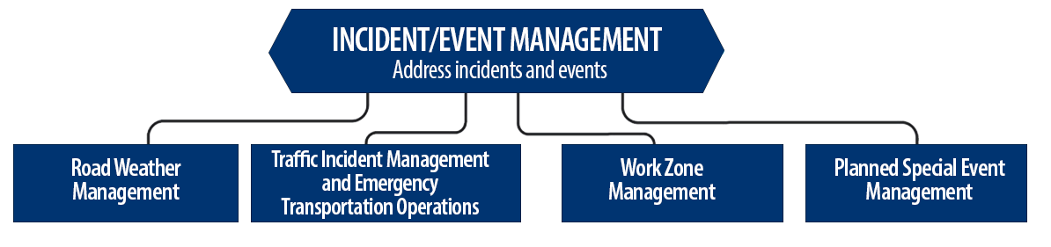
Incident/Event Management Strategies
Source: FHWA.
Notes:
Incident and event management includes several strategies that address major sources of travel-time unreliability.
Incident and event management strategies include road weather management, traffic incident management and emergency transportation operations, work zone management, and planned special event management.
Road weather management activities include creating hazardous weather traffic operations response plans, implementing variable speed limits, detecting hazardous weather conditions, disseminating weather and warnings to travelers through dynamic signs and systems, providing emergency truck and parking facilities and emergency parking information, and implementing vehicle restrictions.
Traffic incident management and emergency transportation operations activities include establishing traffic incident management teams, conducting after action reviews, staging tow trucks in strategic areas, providing roadway safety patrols, integrating computer-aided dispatch into transportation management centers, pre-establishing towing service agreements, co-locating dispatching units, developing quick clearance goals, pre-planning detour routes, implementing shoulder running, deploying adaptive ramp metering, providing variable speed limits, implementing dynamic lane-use controls, deploying network surveillance cameras or detectors, implementing incident traffic signal timing plans, enacting legislation, and integrating traffic management centers with law enforcement dispatch and emergency centers.
Work zone management activities include coordinating maintenance and construction activities, implementing queue length detection, deploying network surveillance cameras or detectors, implementing variable speed limits, supporting dynamic lane merging, implementing dynamic lane-use controls, deploying temporary ramp metering, and implementing dynamic warning systems.
Planned special event management activities include activating special event timing plans, deploying adaptive ramp metering, implementing variable speed limits, using hard shoulder running, activating dynamic transit fare reduction, implementing reversible lanes, supporting dynamic lane-use controls, establishing dynamic pricing, deploying network surveillance cameras or detectors, activating dynamic wayfinding, and conducting after action reviews.
Source: FHWA, Integrating Travel Time Reliability into Transportation System Management: Final Technical Memorandum
https://ops.fhwa.dot.gov/publications/fhwahop19035/index.htm

Slide 19
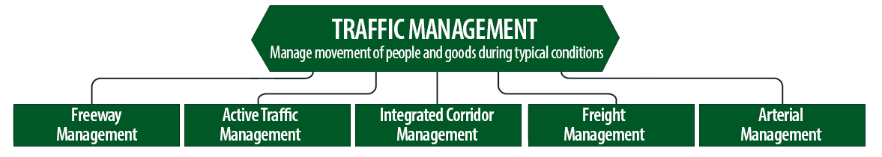
Traffic Management Strategies
Source: FHWA.
Notes:
While incident or event management strategies address atypical events that cause travel-time unreliability, traffic management strategies manage the movement of people and goods during everyday conditions. Even during typical conditions, fluctuations in travel demand can lead to unreliable travel conditions. Traffic management strategies allow the transportation network to adapt to unreliability, including variations in travel demand.
Traffic management strategies include freeway management, active traffic management, integrated corridor management, freight management, and arterial management.
Freeway management activities include implementing traffic surveillance cameras or detectors, using high-occupancy lanes, implementing adaptive ramp metering, deploying hard shoulder running, implementing variable speed limits, deploying dynamic lane-use controls, and constructing physical operations improvements such as overpass widening, curve corrections, or adding auxiliary lanes.
Active traffic management activities include adopting adaptive ramp metering, implementing adaptive traffic signal control, using dynamic lane reversal, implementing dynamic lane-use controls, deploying dynamic merge control, implementing temporary shoulder running, using variable speed limits, deploying queue length detection, providing transit signal priority, and implementing dynamic warning signs.
Integrated corridor management activities include implementing network surveillance cameras or detectors, conducting access management and driveway access controls, implementing adaptive ramp metering, deploying adaptive signal control, deploying transit signal priority, installing queue jumping lanes, providing traveler information for alternative modes, and deploying emergency vehicle preemption.
Freight management activities include implementing roadside truck electronic screening and clearance, implementing truck signal priority, using truck parking management systems, installing truck climbing lanes, and implementing freight loading zone policies.
Arterial management activities include installing queue jumping lanes, deploying transit signal priority, supporting emergency vehicle preemption, implementing network surveillance cameras or detectors, implementing access management and driveway access controls, providing enhanced bicycle and pedestrian crossings, establishing a transportation management center, deploying enhanced traffic signal operations, implementing transit-only lanes, implementing truck traffic signal priority, designing for complete streets, adding capacity for critical movements, reducing travel speeds, providing automated enforcement, and conducting operations asset management.
Source: FHWA, Integrating Travel Time Reliability into Transportation System Management: Final Technical Memorandum
https://ops.fhwa.dot.gov/publications/fhwahop19035/index.htm

Slide 20
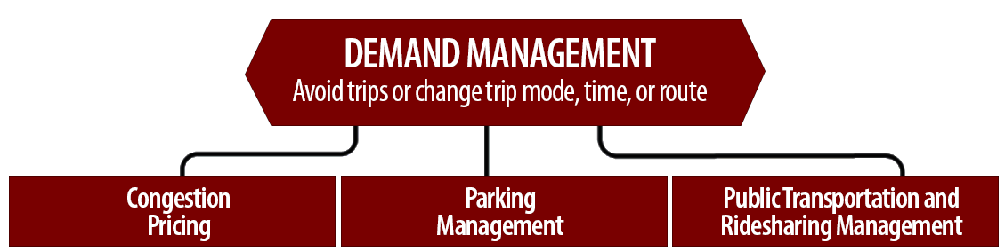
Demand Management Strategies
Source: FHWA.
Notes:
Demand management strategies reduce underlying demand by helping travelers avoid trips or change the mode, timing, or route of trips. This makes nonrecurring congestion less likely to occur and improves travel-time reliability.
Demand management strategies include congestion pricing, parking management, and public transportation and rideshare management.
Congestion pricing activities include implementing dynamic pricing, variable pricing by lane, segment, and time of day or day of week; establishing dynamic transit fare reductions; and deploying managed lanes for high occupancy.
Parking management activities include deploying dynamically priced parking; implementing dynamic parking, wayfinding, reservations, and capacity; deploying dynamic overflow transit parking; implementing electronic payment systems and shared-use parking; and providing incentives to use underutilized parking facilities.
Public transportation and ridesharing management activities include implementing dynamic ridesharing, implementing transit signal priority, using queue-jump lanes at signalized intersections, deploying electronic fare collection and integration, and implementing dynamic surveillance and security.
Source: FHWA, Integrating Travel Time Reliability into Transportation System Management: Final Technical Memorandum
https://ops.fhwa.dot.gov/publications/fhwahop19035/index.htm

Slide 21
TSMO Is a “Way of Thinking” That Supports State Departments of Transportation (DOTs) Missions
“We provide safe, reliable and cost-effective transportation options to improve communities and economic vitality for people and businesses.”
Washington State DOT mission¹
“To provide the best multi-modal transportation system for Colorado that most effectively and safely moves people, goods, and information.”
Colorado DOT mission²
¹ Washington State DOT, “Our Strategic Plan,” https://www.wsdot.wa.gov/about/secretary/strategic-plan/
² Colorado DOT, “Mission, Vision & Values,” https://www.codot.gov/about/mission-and-vision.html
Notes:
TSMO leverages technology, a toolbox of strategies, and engineering solutions to maximize system performance; however, TSMO ultimately involves a way of thinking or a mindset focused on determining the best way to optimize the mobility and reliability of the existing system with limited resources.
TSMO can be thought of as a way of thinking and operating in order to get the most performance out of the transportation network while only building as much as is needed.
The principles of TSMO directly support the missions of many State DOTs, as these examples show.
NOTES:
States can insert their own mission statement here for effect or can leave these in.
Presenters can emphasize the connections between TSMO definition and their specific Mission statement, such as safety, reliability, cost-effective, multimodal, customer’s needs/satisfaction, etc.

Slide 22
TSMO Supports Many State and Local DOT Goals
Reduced congestion
Smoother and more reliable traffic flow
Improved safety
Cleaner air and less wasted fuel
More efficient use of resources and existing facilities
Increased economic vitality
Improved quality of life
Notes:
Here are some common goals in state and local transportation agencies that TSMO strategies support. This list is not exhaustive, but intended to show that TSMO support a range of mission-critical goals. Examples of how TSMO supports these goals are shown on the next slide.

Slide 23
Example TSMO Strategies that Support Transportation Agency Goals
TSMO Strategies |  | Goals
Traffic signal coordination, congestion pricing, demand management |  | Reduced congestion
Manage nonrecurring events (incidents, weather), managed lanes, traveler information |  | Smoother and more reliable traffic flow
Utilize the full system – coordinate all modes, transit signal priority |  | More efficient use of resources and existing facilities
Notes:
TSMO strategies that support some common transportation agency goals are shown here. Many of these strategies support more than one goal, but here are some key examples.

Slide 24
TSMO State of the Practice
Application of TSMO has accelerated in agencies across the country over the past 5-10 years
Recognition of TSMO’s value has grown, leading to a variety of approaches for advancing TSMO in agencies. For example:
  Establishing a TSMO division or office
  Formalizing a TSMO program
  Integrating TSMO throughout the agency
  Establishing a TSMO committee
  Identifying TSMO champions or liaisons
  Conducting a TSMO Capability Maturity Model (CMM) self-assessment
  Developing a TSMO program plan
Notes:
TSMO as a more formal discipline has gained momentum in recent years. Recognition of the importance of TSMO has accelerated in the past five to ten years (as of year of publication of this presentation, 2022).
Key focus areas for agencies during this time have been adapting their culture, processes, expertise, and, in some cases, organizational structures to promote TSMO and a more operationally focused mindset. Agencies approach this differently depending on their unique context and needs. Several examples of key strategies agencies have used to advance TSMO within their organizations are shown here.
Central to all of these organizational approaches is 1) strong support from senior leadership, 2) a champion or champions who understand and promote TSMO throughout the agency, and 3) an openness to learning and cooperation among functions or divisions within an agency.
A TSMO capability maturity model self assessment is a framework developed to help agencies evaluate their current capabilities in the area of TSMO and identify steps for improving their TSMO capabilities. The self-assessment can be accessed at: http://aashtotsmoguidance.org/. There are also other capability maturity frameworks that FHWA has developed to support the implementation of TSMO. More can be learned about those frameworks at: https://ops.fhwa.dot.gov/tsmoframeworktool/index.htm.

Slide 25
Resources on TSMO
What is TSMO? (frequently asked questions) https://ops.fhwa.dot.gov/tsmo
Organizing and Planning for Operations web page https://ops.fhwa.dot.gov/plan4ops
Communicating TSMO web page https://ops.fhwa.dot.gov/plan4ops/focus_areas/communicating_tsmo.htm
National Operations Center of Excellence (NOCoE) Website https://www.transportationops.org/
Enhancing Transportation: Connecting TSMO and Maintenance Factsheet, https://ops.fhwa.dot.gov/publications/fhwahop18090/index.htm
Notes:
While these slides provide a comprehensive, high-level summary of TSMO, participants who are looking for more details and information to share with their staff can visit these virtual resources.

Slide 26
Connecting TSMO and Maintenance

Slide 27
What is Maintenance?
“Maintenance describes work that is performed to maintain the condition of the transportation system or to respond to specific conditions or events that restore the highway system to a functional state of operation. Maintenance is a critical component of an agencies’ asset management plan that is comprised of both routine and preventive maintenance.”
Source: FHWA, “Guidance on Highway Preservation and Maintenance,” Memorandum from the Associate Administrator for Infrastructure, February 25, 2016. Available at: https://www.fhwa.dot.gov/preservation/memos/160225.pdf

Slide 28
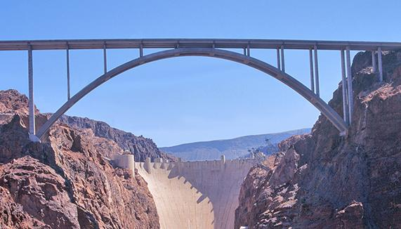
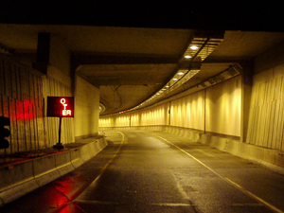
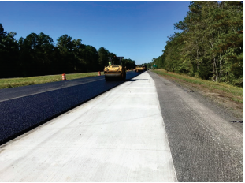
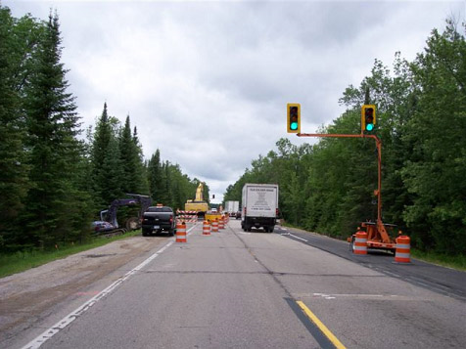
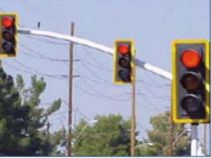
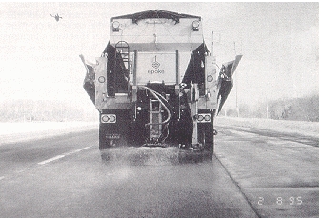
Maintenance Activities
Inspect and maintain bridges
Inspect and maintain tunnels
Maintain and preserve pavement
Maintain signals and ITS infrastructure
Provide winter maintenance
Repair damaged infrastructure
Maintain rights-of-way (ROW)
Clear debris
Respond to incidents
Source: FHWA
Notes:
These are some typical maintenance activities.
Inspect and maintain bridges
Inspect and maintain tunnels
Maintain and preserve pavement
Maintain signals and ITS infrastructure
Provide winter maintenance
Repair damaged infrastructure
Maintain rights-of-way (ROW)
Clear debris
Respond to incidents
Are there other activities that should be included in this list?

Slide 29
TSMO Strategies Support Maintenance
Advance warnings of maintenance, weather, and adverse road conditions
Traveler information to:
  Reduce traffic in work zone
  Reduce impacts to traveling public
Active traffic management strategies:
  Variable speed limits
  End-of-queue warning
  Lane control
  Ramp metering
  Active detours
Traffic management in work zones
Road weather management
Notes:
TSMO strategies that are helpful in increasing safety and mobility around maintenance activities include the following:
Posting messages to variable message signs about maintenance work ahead enables drivers to be more alert as they drive by workers or to divert to another facility and avoid the work area. Operators at transportation management centers in the area are important partners in communicating alerts to travelers
Disseminating traveler information prior to maintenance activities alerts travelers to the time and location of traffic disruptions. By getting this information out early to potential travelers, DOTs can avoid or lessen demand on the facilities where maintenance work is occurring
Activating existing active traffic management strategies manages traffic on the facility dynamically. Examples include variable speed limits to smooth traffic flow and reduce collisions, dynamic shoulder use to add capacity when needed, queue warning systems to prevent incidents, and lane control to indicate which lanes are closed ahead
Coordinating with operators of potentially impacted jurisdictions to plan for and activate detours, signal timing, and ramp meter changes, or to change signal timing smooths the flow of traffic when maintenance work impacts lanes and traffic flow near intersections
Managing traffic within work zones
Supporting road weather management with weather-related detection systems, traffic control strategies, and traveler information
TSMO strategies may be used to reduce or delay construction projects. If capacity expansion can be minimized, this means less highway infrastructure to maintain in the future.

Slide 30
Maintenance Supports TSMO
Preserves transportation system for safe and reliable travel
Maintains TSMO assets
Supports design and implementation of TSMO assets
Provides real-time information from maintenance vehicles (tracking, dash cameras, etc.)
Notes:
Maintenance serves an important role in preserving the existing system, enabling safe and reliable travel on the system.
Maintenance staff keep the physical assets or ITS necessary for many TSMO functions in good operating condition. Assets such as traffic signals, ramp meter/count stations, closed-circuit television cameras, variable message signs, roadway weather information systems (RWIS), and fiber-optic communications infrastructure must be repaired and replaced when necessary to enable the dissemination of traveler information and active traffic management.
Maintenance staff can support roadway design decisions based on potential impacts to maintenance. This includes accessing ITS devices and other TSMO-related equipment for maintenance. Maintenance staff should also provide input to the asset management of ITS devices to ensure that ITS devices are scheduled for maintenance and updated at the appropriate frequency.
Maintenance fleet information from automatic vehicle location (AVL) systems can provide data for dynamic message signs and active traffic management. Maintenance logs can also verify roadway incidents, traveler information and incident response.

Slide 31
Intersections of TSMO and Maintenance
Disseminate traveler information
Employ active traffic management strategies
Coordinate with operators of impacted jurisdictions
Provide road weather information to maintenance crews
Provide information from operations and system performance data
Preserve or maintain intelligent transportation systems (ITS) or other technology to support TSMO
Manage traffic in and around work zones
Notes:
There are several DOT activities that may be points of connection between maintenance and TSMO program staff. These may provide greater opportunities for coordination and collaboration between the programs. This slide lists some examples of the intersections between TSMO and maintenance activities where staff can work together:
Disseminate traveler information prior to and during maintenance activities
Employ active traffic management strategies to smooth traffic flow and prevent incidents in advance of work zones
Coordinate with operators of impacted jurisdictions to plan for smooth traffic flow when maintenance work impacts traffic flow
Provide road weather information to maintenance crews to assist in allocating winter maintenance resources and activities
Provide information from operations and system performance data to support planning for maintenance activities
Preserve or maintain intelligent transportation systems (ITS) or other technology to support TSMO. This includes fiber maintenance, which is critical for ITS device functionality and communication
Manage traffic in and around work zones
(Ask participants if they agree with the examples provided and if they have any other examples of how TSMO and maintenance intersect.)

Slide 32
National Maintenance and Operations Peer Exchange (1/2)
The National Operations Center of Excellence (NOCoE) held a maintenance and operations peer exchange in June 2019
Objective was to facilitate knowledge transfer between operations and maintenance practitioners at State DOTs
Topics of discussion:
  Increasing lane capacity within existing ROW
  Incident management/incident response
  Work zone construction and maintenance needs
  Limitations and restrictions for maintenance in today’s world
  Workforce development: TSMO and maintenance
Notes:
In June 2019, NOCoE held a maintenance peer exchange in Montgomery, Alabama. Hosted by Alabama DOT, the purpose of the peer exchange was to facilitate knowledge transfer between State DOT operations and maintenance practitioners around the country. The peer exchange discussed intersections between TSMO and maintenance.
https://transportationops.org/publications/2019-operations-and-maintenance-peer-exchange
The overall theme for this event was the important synergy that has begun taking place among operations and maintenance divisions in State DOTs and the positive impact this is having on their respective missions and goals.
Topics of discussion included:
Increasing lane capacity within existing ROW
Incident management/incident response
Work zone construction and maintenance needs
Limitations and restrictions for maintenance in today’s world
Workforce development: TSMO and maintenance

Slide 33
National Maintenance and Operations Peer Exchange (2/2)
Findings from the peer exchange include:
  Effectiveness of TSMO strategies such as hard shoulder running depend on collaboration between operations and maintenance
  Maintenance supports TIM by providing equipment, materials, and staff to help clear incidents and then repair shoulders and other infrastructure that may have been damaged.
  Maintenance and TSMO fields face challenges in recruiting employees.
Notes:
The peer exchange included presentations from several State DOTs including Washington, Michigan, Maryland, Tennessee, Minnesota, and Alabama. Some of the findings from the peer exchange include the importance of collaboration between operations and maintenance in implementing TSMO strategies such as hard shoulder running. Additionally, traffic incident management (TIM) is a critical area for maintenance and operations divisions within a DOT to work together. For example, maintenance can support TIM efforts by providing equipment, materials, and staff to help clear incidents. Following the incidents, maintenance can help to repair shoulders or other infrastructure that may have been damaged as a result of the incident. The peer exchange also concluded that maintenance, like TSMO, faces challenges in recruiting employees.

Slide 34
Examples of Connecting TSMO and Maintenance

Slide 35

Tennessee DOT’s TIM and Maintenance Effort
Memorandum of understanding between the Tennessee Departments of Safety and Transportation
Commitment to quick clearance and TIM training
Maintenance employees’ role on incidents
Building relationships between maintenance personnel and emergency responders
Source: @ Getty Images
Notes:
The Memorandum of understanding between the Tennessee Departments of Safety and Transportation (TDOT) includes a commitment to minimize traffic impacts of highway maintenance and to include emergency response needs and priorities in maintenance training.
TDOT is committed to quickly clearing incidents. Maintenance personnel and equipment are often involved in incident response to remove debris or push wreckage from the travel lanes to reopen the highway. Repairs to damaged facilities are scheduled in off-peak hours to minimize further disruptions and improve the safety of maintenance personnel and the traveling public.
TDOT is committed to TIM training for DOT personnel. TDOT and the Department of Safety opened a TIM training facility in 2014. They also hold an annual Highway Safety and Operations Conference that provides an opportunity to review practices and present current national best practices in incident management. The Regional TIM Committees support interdisciplinary TIM training with involvement from District Maintenance staff. Hands-on TIM training is offered to District Maintenance staff, and advanced TIM training is provided to District Maintenance leadership.
TDOT is working to clarify the role of maintenance personnel in rural incidents.
The TIM training facility and the annual safety conference offer opportunities to develop relationships between TDOT personnel, including maintenance personnel and emergency responders. TDOT notes that relationships are essential to effective TIM, and they are a priority for them.

Slide 36
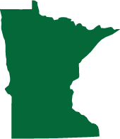
Minnesota DOT (MnDOT)
Work Zone Accident Reduction Deployment Evaluation
  Deployed system to automatically post messages on variable message signs to alert drivers to snowplows or maintenance vehicles ahead
  Developing a system to share this information with connected vehicles and smart phones
TIM strategies for work zones included in MnDOT’s TSMO plan and a training program under development with Minnesota State Patrol
Source: @Getty Images
Notes:
The Minnesota DOT (MnDOT) deployed a system that will automatically post messages on variable message signs to alert drivers to snow plows or maintenance vehicles when an equipped vehicle enters a pre-defined area. The system is used on a 34-mile stretch of Interstate 94 and is intended to improve safety for snow/ice and other maintenance operations. MnDOT is currently developing a system to share this information with connected vehicles and smart phones. MnDOT, Work Zone Accident Reduction Deployment Evaluation, webpage, available at: https://www.dot.state.mn.us/its/projects/2016-2020/wzarde.html.
MnDOT’s TSMO plan identified several TIM strategies for work zones:
TIM response plans for specific work zones
Establish TIM team dedicated to work zone
Dedicated safety service patrols
Training program is under development with the Minnesota State Patrol
They also updated their Open Roads policy to make reopening roads and lanes a priority and changed their Quick Clearance law to provide additional legal force to clear obstructions promptly. These may require support from maintenance resources to push crashes from the roadway and to provide initial traffic control for incidents. TIM operations may also require postponing regular maintenance duties and equipment utilization.

Slide 37
MnDOT Systems Working Together
MnDOT’s Road Weather Information System (RWIS), Maintenance Decision Support System (MDSS), and 511 traveler information system are coordinated:
  RWIS, truck sensors, and driver observation feeds current roadway condition information into MDSS.
  MDSS combines field information with weather forecasts to predict expected road conditions.
  MDSS output generates maintenance recommendations.
  Traveler information system automatically shares current roadway condition through 511mn.org, the traveler information website and mobile application
Notes:
An RWIS is an automated information system that collects, processes, and distributes current and forecasted weather and road surface information.
RWIS stations offer highway camera views of conditions; current temperatures; wind speed; and data about humidity, precipitation, and visibility. MnDOT has approximately 160 RWIS sites spread out along highways in all corners of the State.
That RWIS information, truck sensors, and driver observations feed directly into the Maintenance Decision Support System (MDSS). The MDSS combines field information with weather forecasts to predict expected road conditions and the MDSS output generates maintenance recommendations.
Advanced traveler information systems can provide drivers and fleet operators with RWIS data, including up-to-the-minute warnings about changing conditions. This system allows highway operations managers to use RWIS for timely and cost-effective snow plowing and de-icing.
The systems also share data with the public through the 511mn.org traveler information sites and mobile application, giving drivers in Minnesota the details they need to make good travel decisions. Road conditions are updated more often on 511 with the help of MDSS information. Live video from highway cameras in the 511 system gives users real-time views of winter road conditions and traffic impacts
In addition to making winter operations more efficient, RWIS data are also used in support of 511 traveler information year-round, herbicide applications, pavement marking, incident management, and timing of road maintenance and construction activities: http://www.dot.state.mn.us/maintenance/pdf/2020-winter-maintenance-report.pdf

Slide 38
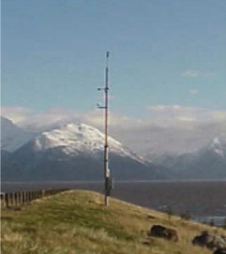
Alaska DOT and Public Facilities Road Weather Information Systems
Access real-time pavement and weather data via computers at the maintenance offices via weather stations that include:
  Pavement sensors to measure surface and subsurface temperatures
  Atmospheric sensors (temperatures, humidity, wind speed, precipitation, snow depth, and stream level)
  Closed-circuit cameras
Improve staff and equipment scheduling
Increase winter maintenance efficiency
Improve mobility for traveling public by minimizing exposure to hazardous roadway conditions
Source: Alaska DOT&PF
Notes:
The Alaska DOT and Public Facilities (ADOT&PF) also operates a network of road weather stations that are strategically located along the highway system. This supports TSMO by improving mobility for the traveling public by minimizing the public’s exposure to hazardous roadway conditions. This occurs either through traveler information warning motorists to avoid roads or by improving the roadway conditions through more efficient maintenance.
Agency personnel access the real-time pavement and weather data via computer workstations at the maintenance office.
Alaska's RWIS stations may include some or all of the following:
Pavement sensors in travel lanes to measure surface and subsurface (17 inches below the surface) temperatures
Atmospheric sensors adjacent to the roadway to measure air temperature, dew point temperature, relative humidity, wind speed and direction, precipitation occurrence, precipitation accumulation, atmospheric station pressure, snow depth, or stream water level
Closed circuit cameras that take images of the roadway for snow and ice control as well as for traveler information. ADOT&PF also provides images of mountains and passes to supplement the Federal Aviation Administration web camera program
This information allows ADOT&PF to better schedule maintenance personnel and equipment based on current and forecasted weather and pavement surface conditions. Real-time weather information can:
Improve timeliness of maintenance actions
Increase winter maintenance efficiency
Minimize the traveling public's exposure to hazardous weather-related roadway conditions.
http://roadweather.alaska.gov/iways/roadweather/forms/About.html
The photograph is of the RWIS site at Bird Point on Seward Highway, http://roadweather.alaska.gov/iways/roadweather/forms/About.html

Slide 39
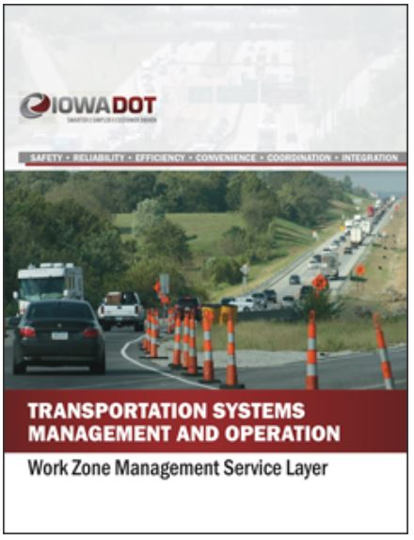
Iowa TSMO Work Zone Service Layer
Identified work zone management objectives for each of the six TSMO goals
Looked at opportunities created by TSMO-based approach
Work zone groups support mobility and safety in work zones
Work zone data and gap analysis
Recommended actions to address gaps
Source: Iowa DOT
Notes:
Iowa DOT’s TSMO Program Plan includes eight service layers. One of the service layers is work zone management. The Work Zone Management Service Layer Plan was completed in 2018 and focuses on the planning and deployment of TSMO strategies to maintain traffic flow and safety through work zones. This applies to both construction and maintenance work zones.
The six TSMO goals are safety, reliability, efficiency, convenience, coordination, and integration.
The plan identified the relationship between work zone management and each of the other seven service layers.
Multiple groups and committees focus on ensuring proper application of temporary traffic control:
Work Zone Traffic Safety Committee
Work Zone Process Review Team
Traffic Critical Projects (TCP) Working Group
Intelligent Work Zone Team
TCPs Mitigation Committee
Specification Committee
Major Projects Group
Roadway Industry Safety Committee
Work Zone Training Group
The plan analyzed current data and monitoring procedures for work zones and completed a gap analysis of work zone management practices across dimensions of TSMO capabilities. This was used to identify specific work zone management initiatives and recommended actions.
The recommended actions are to:
Create a work zone data hub
Determine standard delay in TCP work zones
Hold an annual two-day information-sharing workshop
Create a work zone library
Review the current plan development process and collaboration tools
Transition from managed TCP to in-house TCP

Slide 40
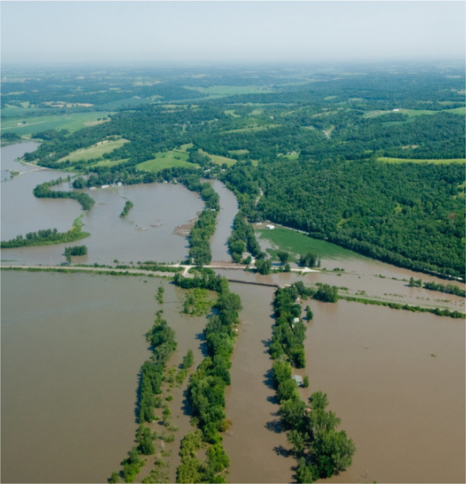
Weather-Related Data, Tools, and Collaborations
Iowa, Missouri, and Nebraska DOTs share data during major flood events
Flooding on Missouri River in 2011 and 2019 caused impacts and closures, resulting in long-term recovery and reconstruction
Many DOTs use weather-related data and tools to predict and prepare for flooding
Agencies, departments, and other stakeholders coordinate preparation, response, and recovery
Sharing road condition information between maintenance and operations staff supports accurate traveler information.
Source: Missouri DOT
Notes:
Iowa, Missouri, and Nebraska DOTs understand the importance of data, tools, and collaboration when managing major flood events. Responding to major weather events often requires both TSMO and maintenance staff within a DOT. One of the important aspects of coordination is traveler information in which maintenance crews can provide road condition information during their work on the roads to operators to disseminate to travelers. Operators can also provide information to maintenance crews obtained from cameras, crowd-sourced data, and other sources of information. This coordination supports TSMO by improving mobility for the traveling public by minimizing the public’s exposure to hazardous roadway conditions.
The Missouri River Basin typically experiences some annual flooding in the spring as a result of snowmelt from upstream areas and increased rainfall. Levees, dams, and other infrastructure are in place to help control the floods and minimize the impacts of this annual cycle. Significant flood events on the Missouri River in 2011 and 2019 caused major, prolonged impacts and road closures, resulting in recovery and reconstruction efforts lasting for many months.
Weather-responsive management strategies can mitigate the impact of flooding events through preparation and prediction efforts that leverage and build data, tools, and relationships. As a result, agencies are better equipped for response and recovery efforts that support the safe mobility of travelers. This includes promptly disseminating traveler information regarding unsafe conditions and road closures across state lines so that travelers, especially truck drivers, delay or otherwise change their trips to avoid major delays.
DOTs rely on a variety of weather-related data and tools to predict and prepare for flooding. Below are examples of data and tools used by DOTs:
River Gauge Data - Missouri DOT actively used the National Oceanic and Atmospheric Administration (NOAA)/National Weather Service river gauge and hydrograph predictions to plan for closures. Notes included with the NOAA hydrograph information contain several details, such as water levels that will impact downstream bridges. This information was available to Missouri DOT supervisors on their mobile devices. It helped staff understand when water was being released from upstream dams and where to position equipment and staff, as needed, to keep roads open for as long as possible before floodwaters crossed a road.
Hydrologic Modeling - To understand water flow, potential impacts, and road-overtopping risks, analysts use a variety of hydrologic models available at DOTs and from university partners. For example, Iowa DOT utilized a two-dimensional hydraulic model called TUFLOW® that determined the stages and velocities along the entire 50 river miles of the Missouri River for 32 miles of Interstate 29 and three major highway crossings (see the photograph in the slide). This provided forecasting, assessment, and response information as the U.S. Army Corps of Engineers (USACE) temporarily repaired the levee system to a 25-year flood level over the 6 months following the March 2019 flood event. Hydraulic modeling also provided detailed information for emergency relief betterment analysis to improve resiliency options for DOT infrastructure.
Light Detection and Ranging (LiDAR) Mapping - Iowa DOT used a LiDAR map, accurate to within an 8-inch elevation, to model where water would pool over large areas, whether the road may act as a dam or allow water to go over the top, and where to sandbag. These data were essential to Iowa DOT for relating the Missouri River stream gauge information to potential infrastructure impacts, particularly after levee breaches caused by the March 2019 flood made infrastructure more vulnerable to subsequent flooding. The LiDAR map facilitated a proactive response that would otherwise require maintenance staff on the ground for updates.
Data Repositories - Iowa DOT used centralized databases with flood-related resilience and monitoring information, alongside infrastructure information, to facilitate quick assessment. Data repositories can be used at a microscopic level to inform related hydrologic modeling efforts, because a couple inches of water can make the difference between normal operations and a closure. Similarly, Missouri DOT maintains a bridge database that contains detailed information, including plans and photos for bridges. This was especially helpful in their preparation for understanding when water would rise to critical scour points.
Personnel must coordinate and work with staff from a variety of agencies, departments, and other stakeholders, for example:
USACE develops plans for an upstream water release, which can increase flooding
Railroad companies may use public roadways to transport heavy loads for rebuilding infrastructure damaged by floods, causing major rutting and additional damage to roads with an unclear timeline of project completion and cost for the State DOT
Commercial motor carriers support flood recovery efforts and require input from the State DOT about routes to transport recovery materials, as well as everyday goods and services
Hydrology and hydraulic staff at the State DOT, university partners, or private weather service providers
Hazardous materials teams are important during recovery, as a lot of potentially hazardous materials and refuse get washed onto roadways and State DOT right-of-ways during floods
Other specific examples:
Iowa DOT noted that the Department of Corrections was engaged in advance of a flood event to provide labor to fill sandbags
The National Guard helped supply aid to a Nebraska community that could not be accessed by road due to flood waters. The 2019 flood also prompted Nebraska DOT to engage the Game and Parks Department to use airboats and officer operators to inspect flood damage. The State DOT may also engage county agencies, the Department of Agriculture, and the U.S. Geological Survey to support flood-related efforts
The Missouri DOT uses its Traveler Information Map to share information with other agencies and travelers on closures for flooding and winter weather. Cameras on the Traveler Information Map can be opened by the public to see weather conditions or crashes on the roads.
https://ops.fhwa.dot.gov/publications/fhwahop20050/index.htm
The photograph can be located at https://flic.kr/p/a1pwfX

Slide 41

Virginia DOT (VDOT) Lane Closure Management
VDOT uses a lane closure advisory management system (LCAMS)
LCAMS is used:
  To proactively manage and communicate lane closures
  For public awareness through web and 511 system
  To avoid road work scheduling conflicts
  To prioritize work
Source: @Getty Images
Notes:
The Virginia DOT, or VDOT, uses the lane closure advisory management system (LCAMS) to proactively manage and communicate lane closures across the State. The LCMAS information is used for public awareness through the Virginia traffic tool and the 511 system. One of the most important features of LCAMS is its ability to help avoid conflicts when scheduling road work, including maintenance. If two requests for construction or maintenance conflict, the system notifies the two users that there is a conflict and asks them to change dates/time. The system gives preference to high-priority work (i.e., design-build, major structure repair, etc.).

Slide 42
Road Weather-Related Dashboards
Idaho Transportation Department Dashboard
Iowa DOT Performance Dashboard
MnDOT Performance Reports and Performance Dashboard
Missouri DOT Tracker and Traveler Information Map
Wisconsin DOT Annual Winter Maintenance Report and the Mobility, Accountability, Preservation, Safety, Service Program
Source: Idaho Transportation Department
Notes:
Road weather management is both a TSMO and maintenance activity in many States. It is an area where TSMO professionals work to get road weather information out to the public and much of that information comes from maintenance vehicles/snow plows and RWIS stations.
Many agencies are using data to support public-facing or internal dashboards on performance, material usage, costs, or savings; return on investment analyses; internal determination of resource allocation; or other reports.
Several State DOTs assimilate road weather information for display on performance management dashboards or to develop performance management reports. Below are examples of some that are provided for public use, and others that are intended only for internal consumption.
The Idaho Transportation Department Dashboard provides an annual average measure of the percentage of time highways are clear of snow and ice during winter storms. This average is compared against the agency’s goal of maintaining at least 73-percent unimpeded mobility. The dashboard is at: https://apps.itd.idaho.gov/Apps/Dashboard/.
The Iowa DOT Performance Dashboard contains winter operations measures that include the average time it takes for roadways to be returned to normal surface conditions for each of three maintenance service levels that are designated based on the roadway type. The webpage provides current and historic averages of weather measures, like the weather severity index (WSI) and salt use, reported bi-weekly through the winter season, as well as annual historic measures of weather (e.g., WSI, snowfall quantity, and snow events) and costs (e.g., labor, equipment, and material).
The MnDOT Performance Reports and Performance Dashboard is a performance dashboard MnDOT uses to provide information on the percentage frequency at which they meet the bare lane target of 70 percent, which is a number of hours based on traffic volumes for the roadways during the winter season. The dashboard also reports actual salt use, actual versus optimal salt use, and WSI for each season. Previously, MnDOT published this information as part of an annual transportation scorecard and performance report.
The Missouri DOT Tracker is a quarterly report that is available online and includes a section for Winter Storm Operations that tracks average time to meet winter storm event performance objectives for both continuous operation routes and non-continuous operation routes and annual cost of winter operations. The Missouri DOT uses its Traveler Information Map to share info on closures for flooding and winter weather. Cameras on the Traveler Information Map system can be opened by the public to see weather conditions on roads.
The Wisconsin DOT Annual Winter Maintenance Report and the Mobility, Accountability, Preservation, Safety, Service Program is an annual winter maintenance report that includes a variety of measures for each winter season to compare year-to-year performance, including information about weather conditions, cost and quantity of materials, labor hours, average crew reaction time, and assets.
Source: FHWA, Leveraging Road Weather Data for Performance Management Dashboards and Reports. Available at: https://ops.fhwa.dot.gov/publications/fhwahop20051/index.htm

Slide 43
New Jersey DOT ITS Maintenance Contracts
Challenge
Traditional maintenance contracting approach ill-suited for ITS maintenance
Required forecasting equipment repair needs
Caused extended ITS downtime and multiple change orders with unplanned work
Minimal control over workflow
New Jersey’s Solution
Division of Mobility Engineering began ITS Maintenance Job Order Contracts in 2014.
Developed Construction Task Catalog (CTC) of individual maintenance tasks for contractor bids
Greater control of workflow
Reduced need for predetermined work
More efficient use of funding
For more information, see https://transportationops.org/case-studies/job-order-contracts-its-maintenance
Notes:
Challenge: The New Jersey DOT (NJDOT) used a traditional maintenance contracting approach to obtain ITS maintenance services, which created several challenges. The contracting approach required NJDOT’s ITS maintenance staff to anticipate what ITS equipment would need to be fixed or replaced during the contract period resulting in some systems to be inoperable for an extended period and unplanned work causing multiple change orders. NJDOT had minimal control over workflow and difficulty incorporating unplanned work.
Solution: NJDOT’s Division of Mobility Engineering began developing the nation’s first ever ITS Maintenance Job Order Contracts (ITS JOCs) in the summer of 2014. It developed a Construction Task Catalog (CTC) with individual tasks. Each task includes the materials and labor required for each task. The contractors submit bids for the CTC and allows NJDOT to order specific tasks under a contract. That provides NJDOT greater control over workflow, less need to forecast what maintenance work will be needed, a more efficient use of funding, and a more competitive bidding process.
For more information, see the National Operations Center of Excellence’s case study:
https://transportationops.org/case-studies/job-order-contracts-its-maintenance

Slide 44
Arizona DOT: Increasing TSMO Knowledge of Internal Maintenance Staff (1/2)
Arizona DOT created a TSMO Division in 2015
TSMO Division combined multiple maintenance units in Arizona DOT
  Signal Operations
  ITS Maintenance
  Pump Stations
  Lighting and Tunnel Operations
  Fiber Management
Challenges
  High turnover and lack of cross-training
  TSMO maintenance positions were required more specialized skills/knowledge because of technology in field equipment
Notes:
Arizona DOT (ADOT) created a TSMO Division in 2015, combined several units include maintenance functions. These maintenance units included traffic signal maintenance, lighting maintenance, traffic electronics bench, intelligent transportation systems (ITS) maintenance, tunnel operations, and roadway pump systems maintenance. ADOT was not compensating for the increased qualifications resulting in many staff leaving for other agencies shortly after receiving on-the-job training.
Challenges: High turnover and lack of cross training were the two major issues challenging maintenance units. TSMO maintenance positions were more technical in nature than general roadway maintenance and required more specialized training/background particularly due to the increased use of technology in the field equipment.
Source: National Operations Center of Excellence (NOCoE), Maintenance Staff Training: Increasing Internal TSMO Knowledge, Case Study, 2019. https://transportationops.org/case-studies/maintenance-staff-training-increasing-internal-tsmo-knowledge

Slide 45

Arizona DOT: Increasing TSMO Knowledge of Internal Maintenance Staff (2/2)
Arizona’s Solution
  Developed Signal, Lighting, and Technical Electrical (SLATE) training program
  Established a formal criteria-based promotional ladder specific to TSMO in order to train, maintain, and retain TSMO technical staff
  Created a common core of knowledge to allow staff sharing across units
  Positive staff feedback and reduced turnover
Source: @Getty Images
For more information, see https://transportationops.org/case-studies/maintenance-staff-training-increasing-internal-tsmo-knowledge
Notes:
Solutions: Developed Signal, Lighting, and Technical Electrical (SLATE) training program is a formal criteria-based promotional ladder specific to TSMO in order to train, maintain, and retain TSMO technical staff. The new structure was developed based on revised position descriptions and knowledge, skills, and abilities (KSA). All TSM&O maintenance staff within the technical electrical fields were transferred to the new common position – SLATE Technician. Common to all categories is a core set of classes providing base knowledge in signal operations, ITS maintenance, high voltage, and aerial lifts. This base knowledge allows for some sharing of resources across units. The new SLATE classification and training matrices were implemented within a year of the TSMO Division being created. Feedback from staff has been positive and turnover within the signal, lighting, and technical electrical maintenance units has reduced significantly.
Source: National Operations Center of Excellence (NOCoE), Maintenance Staff Training: Increasing Internal TSMO Knowledge, Case Study, 2019. https://transportationops.org/case-studies/maintenance-staff-training-increasing-internal-tsmo-knowledge

Slide 46
Georgia DOT: Coordinated Highway Assistance and Maintenance Program (CHAMP) (1/2)
Georgia DOT’s roadside assistance and maintenance program
Covers Georgia interstates outside of metro Atlanta
Addresses both TSMO and maintenance needs in priority order:
  Lane blocking incidents
  Shoulder blocking incidents
  Routine maintenance issues and
  Motorists requiring routine assistance
Funded by the Georgia Transportation Funding Act of 2015
Supports Georgia DOT’s maintenance crews
Notes:
CHAMP, the Coordinated Highway Assistance and Maintenance Program, is Georgia DOT’s roadside assistance and maintenance program covering Georgia interstates outside of metro Atlanta with the exception of short stretches of I-59 and I-24. CHAMP operators began their assistance in early February 2017.
CHAMP addresses both TSMO and maintenance concerns. These include the following concerns in priority order:
Lane blocking incidents
Shoulder blocking incidents
Routine maintenance issues and
Motorists requiring routine assistance
CHAMP was made possible by the passage of the Transportation Funding Act of 2015 in Georgia. CHAMP supports the Georgia DOT maintenance crews by taking on requests for work that the maintenance department used to receive, but were unrelated to their regular jobs. This created a backlog of work for the maintenance department.

Slide 47
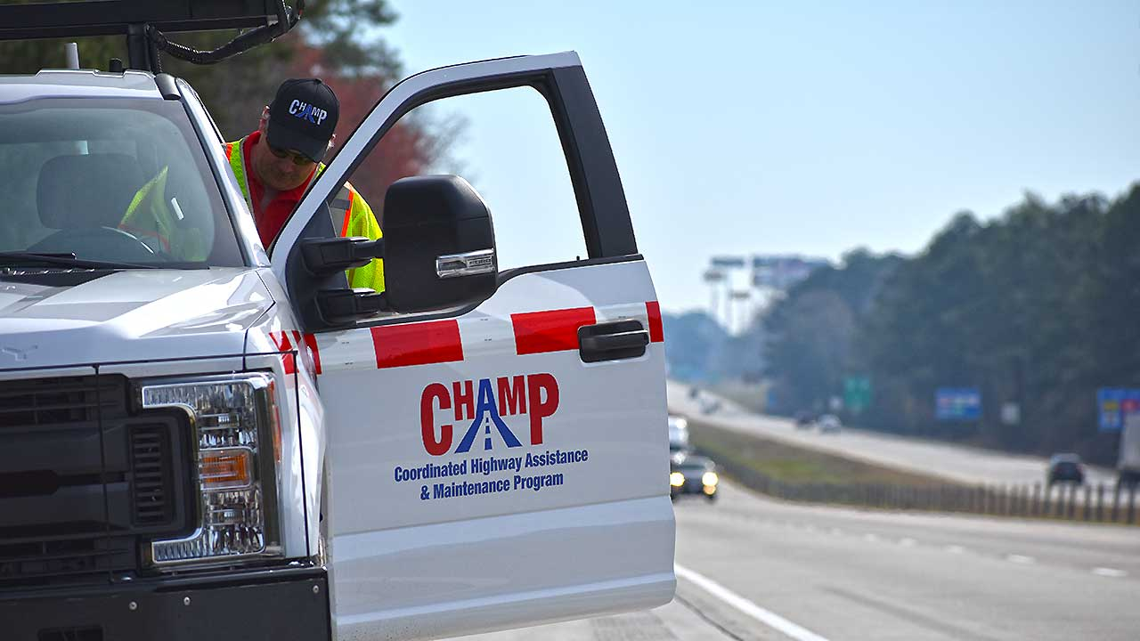
Georgia DOT: Coordinated Highway Assistance and Maintenance Program (CHAMP) (2/2)
CHAMP provides quick response to a variety of maintenance issues:
Bridge/roadway damage
Down signs
Missing roadway markings
Traffic signal malfunction
Commercial vehicle crashes and spills
Vegetation
Blocked drainage
Debris removal
Source: Georgia DOT.
For more information, see: https://transportationops.org/case-studies/coordinated-highway-assistance-and-maintenance-program-champ
Notes:
One of the major areas of assistance provided by CHAMP is quick response to maintenance issues. This slide lists a variety of major and minor maintenance issues that CHAMP covers. These include:
Bridge/roadway damage
Down signs
Missing roadway markings
Traffic signal malfunction
Commercial vehicle crashes and spills
Vegetation
Blocked drainage
Debris removal (including abandoned or disable vehicles)
To learn more about CHAMP, see that National Operations Center of Excellence 2019 case study at: https://transportationops.org/case-studies/coordinated-highway-assistance-and-maintenance-program-champ.
Source of photo: Georgia DOT, http://www.dot.ga.gov/DS/Travel/CHAMP#tab-2

Slide 48
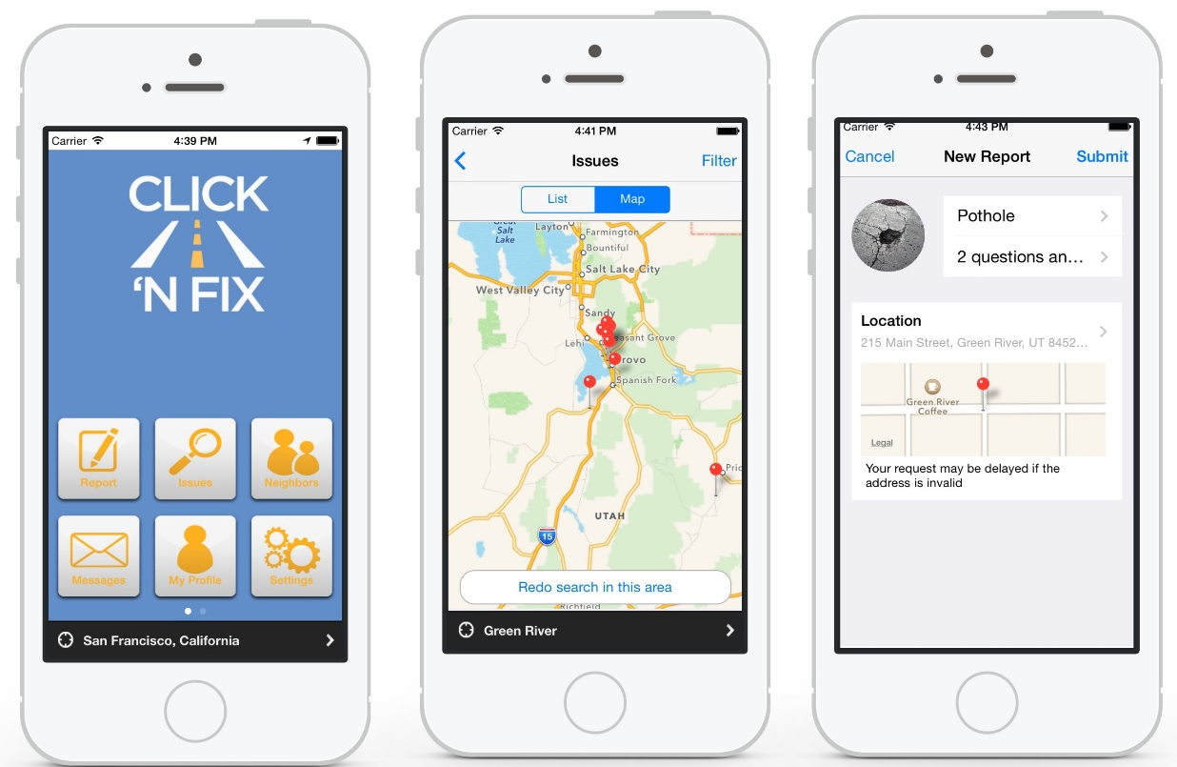
Utah DOT Crowdsources Maintenance and Operations Requests
Utah DOT launched Click ‘n Fix in 2015.
Smartphone application and website allows citizens to report roadway issues with photos and dropping a pin on a map.
Focused on roadway maintenance and signal operations issues to improve safety and mobility
Source: Utah DOT.
For more information, see: https://blog.udot.utah.gov/2015/01/udot-click-n-fix/
Notes:
The Utah DOT worked with a third-party software company to customize Click ‘n Fix, a solution for citizen reporting of roadway maintenance and signal operations issues on State and Federal highways in Utah. In 2015, the Utah DOT launched Click ‘n Fix, a smartphone application and website that allows citizens to take pictures of maintenance issues and send them to the Utah DOT (along with geo-located photos, attributes, etc.). In addition to collecting citizen requests, the solution acts as a service-request management system that can help to improve agency efficiencies and transparency.
Citizens report roadway issues that relate to infrastructure maintenance, signal and ramp meter operations, and safety. Potholes, signal outages, signage issues, and road debris are commonly reported. Additionally, reports of ramp meters causing backups, transit signal priority issues, and bicycle safety concerns also feed into Utah DOT through this application.
More information can be found at: https://blog.udot.utah.gov/2015/01/udot-click-n-fix.
Image Source: Utah DOT, SeeClickFix Website. Available at: https://seeclickfix.com/pages/case-studies/utah-dot.html.
More information can be found at: https://blog.udot.utah.gov/2015/01/udot-click-n-fix.

Slide 49
Overcoming Challenges to Collaboration

Slide 50
Identifying the Challenges to Collaboration
Lack of understanding of the term TSMO or its focus by maintenance staff
Silos in the organizational structure limiting interaction between maintenance and TSMO programs
Lack of funding or staff time to support data and information sharing between disciplines
Need for additional funding, training, and defined responsibilities between functional areas to manage TSMO assets
Recruiting and retaining employees with expertise necessary to maintain TSMO assets
Scheduling maintenance activities to avoid congestion impacts
Notes:
To effectively coordinate between TSMO and maintenance, it is important to consider these points:
TSMO versus operations and maintenance and system management versus operations and maintenance. Terminology can add to confusion about what TSMO is and its benefits, so understanding the differences in meaning is important. Over the years, the terms O&M (operations and maintenance), M&O (management and operations), and TSMO have been used to described various DOT functions. O&M is a traditional term for system upkeep and preservation. M&O focuses on optimizing the performance of existing facilities. TSMO (transportation systems management and operations) looks more broadly across modes and disciplines and may encompass activities traditionally included under O&M and M&O. This similar but different terminology can lead to confusion in discussing opportunities for mutual benefit of coordinating TMSO and maintenance.
Silos or minimal interaction between TSMO and maintenance personnel. There may be differing levels of coordination at the statewide, region, and district levels. Some DOTs have restructured to include maintenance in their TSMO or operations units. Where maintenance is a separate unit from operations, additional communication is needed to explore how TSMO strategies can be used to support maintenance objectives.
Additional funding is needed to support data and information sharing between TSMO and maintenance to support both functions. Maintenance and TSMO collect data pertinent to their responsibilities. Much of that data may be helpful to the other function and funding is often needed to expand data sharing. For example, road weather data used in maintenance can be used to develop operations and public information strategies to improve system operations and safety. Incident data can be shared between maintenance logs and crash reports to target improvements in both maintenance and operations.
Additional funding and an understanding of device lifecycles and project needs are needed to ensure maintenance of TSMO assets and device up-time. As TSMO assets are deployed, the responsibility for maintenance requires additional funding, training, and defined responsibilities between functional areas.
Recruiting and retaining employees with knowledge of TSMO applications who will be valuable in supporting maintenance and asset management may be a challenge. Training current staff to maintain TSMO applications requires time, money, and expertise. Without the needed staffing, it becomes difficult to adequately maintain additional TSMO assets.
Scheduling maintenance activities can be challenging. Limitations to worker hours and labor rules may reduce the ability of maintenance staff to coordinate with TSMO staff to reduce peak period work zones.

Slide 51
Opportunities for Enhancing Collaboration
TSMO training for maintenance personnel
Data sharing between maintenance and TSMO for decision support
TSMO infrastructure included in asset management and maintenance management systems
Road weather management and emergency operations
Engage TSMO personnel in work zone management policy development
Engage maintenance personnel in TSMO program planning
Include maintenance in TSMO committees
Involve maintenance in design and deployment of TSMO assets
Notes:
There are numerous opportunities to enhance coordination between TSMO and maintenance, as illustrated in these bullets:
TSMO training for maintenance personnel to address lack of understanding of TSMO
Data sharing between maintenance and TSMO for decision support
TSMO infrastructure included in asset management and maintenance management systems
Road weather management and emergency operations
Engage TSMO personnel in work zone management policy development
Engage maintenance personnel in TSMO program planning
Include maintenance in TSMO committees
Involve maintenance in design and deployment of TSMO assets (technology and supporting infrastructure that enable TSMO strategies including signals, variable message signs, gantries, cameras, communications systems)
In addition to those opportunities on the slide, other ways that maintenance and TSMO staff or programs can collaborate include:
TMCs can share information with maintenance staff on the traffic impacts on work zones and recommend work zone schedules to reduce or avoid traffic impacts and allow maintenance workers more lane and shoulder closures for safety.
TSMO and maintenance can coordinate on traveler information and lane closures when planning sign installation and replacement over live traffic lanes.
TMCs that gather incident and congestion data from crowdsourced smartphone applications can also collect and share pothole locations and other maintenance needs reported by travelers with maintenance staff.
Maintenance and TSMO programs can jointly develop uptime targets and requirements for devices (whether maintenance is done in-house or by vendors).
Maintenance staff can work with TMCs for situational awareness before, during, and after road work.
(Training focus should be on understanding TSMO, what it offers, and how it can be used to support maintenance.)

Slide 52
Next Steps

Slide 53
Near-term Opportunities
Start a conversation
Provide TSMO overview to maintenance personnel
Invite maintenance personnel to TSMO training and committee meetings
Invite TSMO staff to maintenance committee meetings
Include maintenance in TIM committees and training
Participate together in the American Association of State Highway and Transportation Officials (AASHTO) Committee on Maintenance activities
Other ideas for collaboration in the near term?
Notes:
There are several opportunities for near-term collaboration between TSMO and maintenance staff. These include just starting a conversation or meeting on how to better coordinate, providing this overview of TSMO to maintenance personnel, inviting them to TSMO trainings or committees (and vice versa), and including maintenance staff in TIM training or groups. Additionally, the American Association of State Highway and Transportation Officials (AASHTO) Committee on Maintenance is an active group with meetings and other activities that can be useful opportunities for TSMO and maintenance staff within a DOT to participate together.
(Other ideas?)

Slide 54
Long-term Opportunities
Create a standing committee on TSMO and maintenance
Include TSMO in maintenance training and manuals
Integrate TSMO and maintenance data (road weather, traffic, global positioning system tracking, incident, etc.)
Provide smart work zone or other portable TSMO technologies to maintenance
Review and revise protocols to integrate TSMO and maintenance (notifications, asset management, etc.)
Monitor and document effectiveness of TSMO applications in maintenance
Develop contract specifications and performance requirements jointly with maintenance personnel
Other ideas for collaboration in the long term?
Notes:
There are also several opportunities for TSMO and maintenance staff to collaborate in the long term. These include creating a standing committee on TSMO and maintenance, including TSMO in maintenance training and manuals, integrating data, sharing TSMO strategies for managing traffic during work zones, revising protocols for connecting TSMO and maintenance activities and asset management, and monitoring the effectiveness of TSMO in work zones.
What other ideas can you think of?

Slide 55
Resources
Federal Highway Administration (FHWA), What is TSMO? (frequently asked questions), https://ops.fhwa.dot.gov/tsmo
FHWA, Enhancing Transportation: Connecting TSMO and Maintenance, Factsheet, 2018, https://ops.fhwa.dot.gov/publications/fhwahop18090/
FHWA, Communicating TSMO web page, https://ops.fhwa.dot.gov/plan4ops/focus_areas/communicating_tsmo.htm
NOCoE website, https://www.transportationops.org/
NOCoE Operations and Maintenance Peer Exchange, https://transportationops.org/publications/2019-operations-and-maintenance-peer-exchange
AASHTO Committee on Maintenance website, https://maintenance.transportation.org/
Notes:
There are multiple sources of information that can help with your understanding of TSMO from FHWA, AASHTO, and the National Operations Center of Excellence.

Slide 56
Thank you!

